Slide 1
2- Wasserstein GANs
Risman Adnan Mattotorang
Software R&D Director
Samsung R&D Institute Indonesia

Slide 2
Welcome to Data Science Center UI
What You Will Learn Today
Known Problems with GANs
Introduction to Optimal Transport Theory
Wasserstein GAN Formulation
WGAN Regularization Techniques
What You Will Practice Today
Setup Your WGAN experiments (Collab, PyTorch)
Create Your First WGAN
Implement Various WGAN Regularization Techniques

Slide 3
Outline
Known Problems in GANs
Beyond KL and JS Divergences
Introduction to Optimal Transport
Wasserstein GAN Formulation (WGAN)
WGAN Regularization Techniques
Home Work 2

Slide 4
Known Problems in GANs
Training GANs requires finding Nash equilibrium of a non-convex game with continuous, high dimensional parameters. A Nash equilibrium is a point such that cost functions of D and G are both at minimum. Finding Nash equilibrium is a hard research problem.
Algorithms exist for specialized cases, but hard to apply to the GANs cases, where the cost functions are non-convex, the parameters are continuous, and the parameter space is extremely high-dimensional.
Gradient descent techniques are designed to find low value of cost function, rather than to find the Nash equilibrium of minimax game. When used to seek Nash equilibrium Gradient descent is showing instability issue and may fail to converge.
Well known non-convergence issues in GANs are:
Vanishing Gradient
Mode Collapse
One way to overcome this is to use
better divergence formulation of GANs

Slide 5
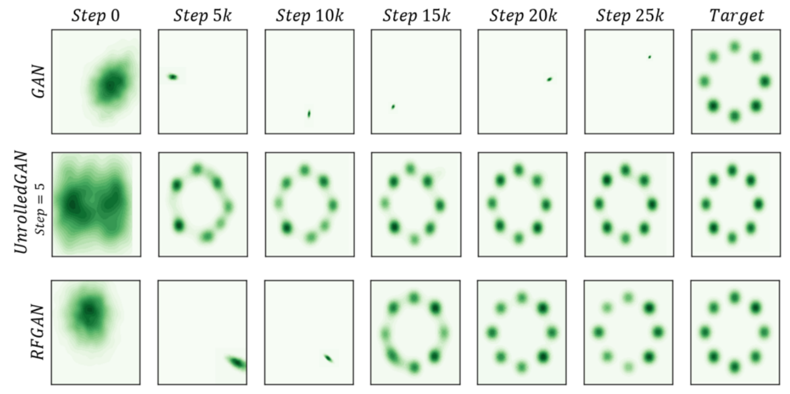
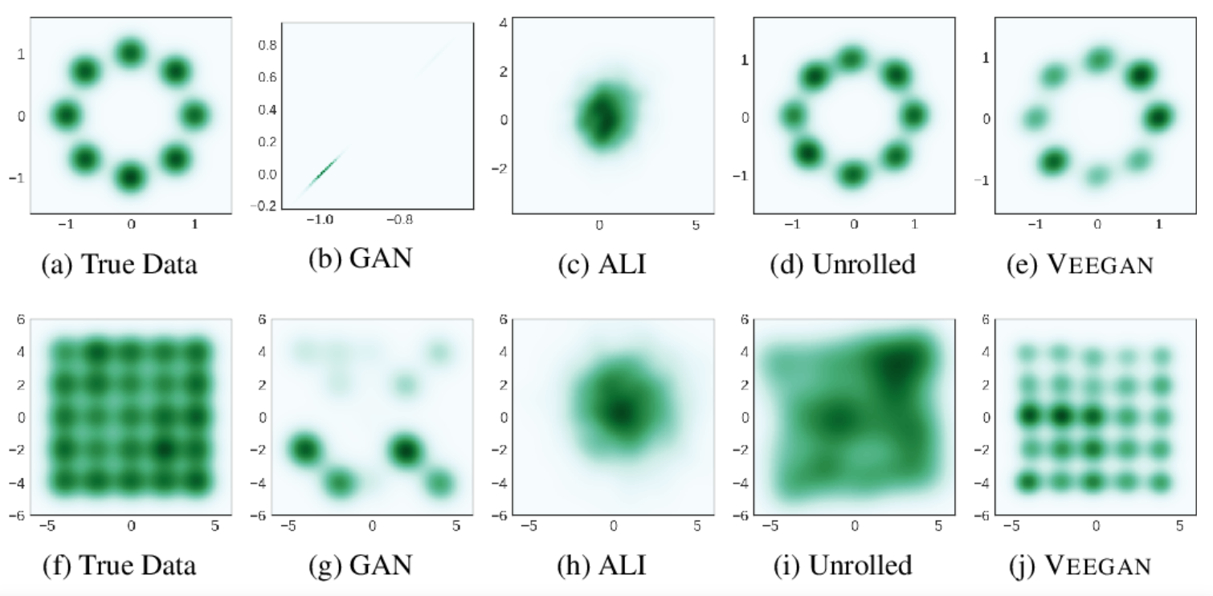
Mode Collapse
Mode collapse is when the generator generates a limited diversity of samples, or even the same sample, regardless of the input. It happens in many types of GANs

Slide 6
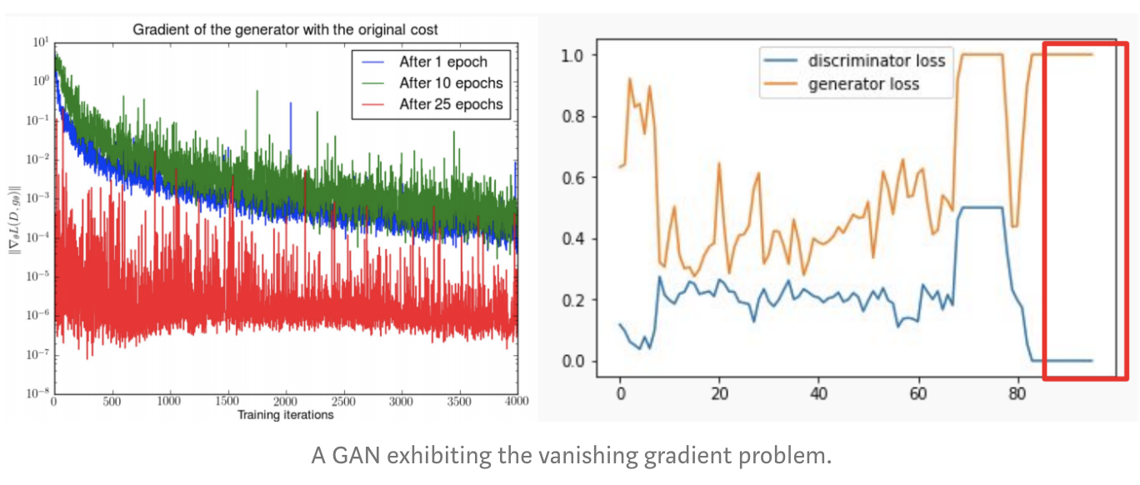
Vanishing Gradient
Vanishing Gradient happens when discriminator gets too successful that the generator gradient vanishes and learns nothing.

Slide 7
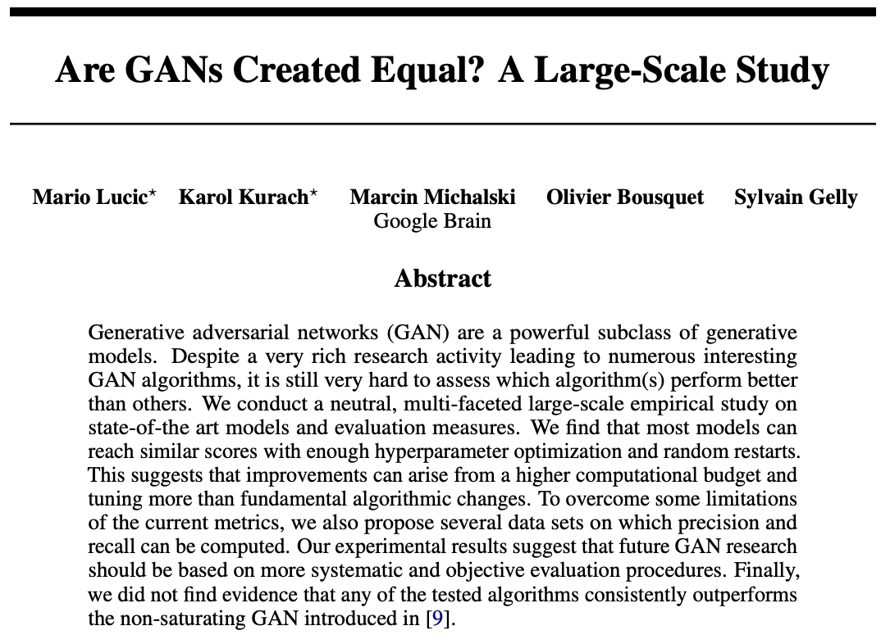
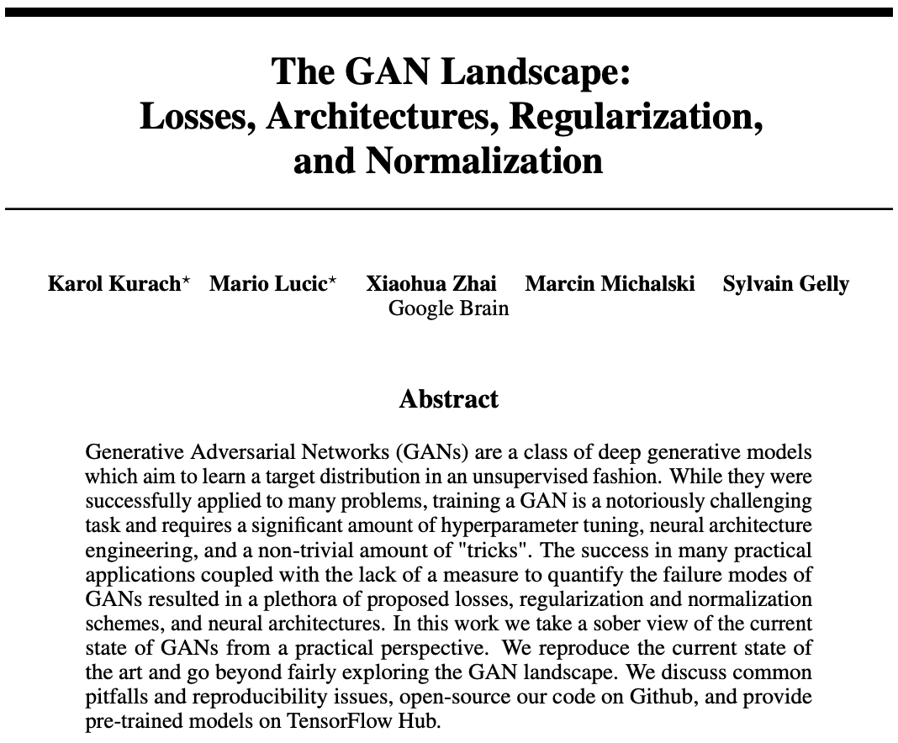
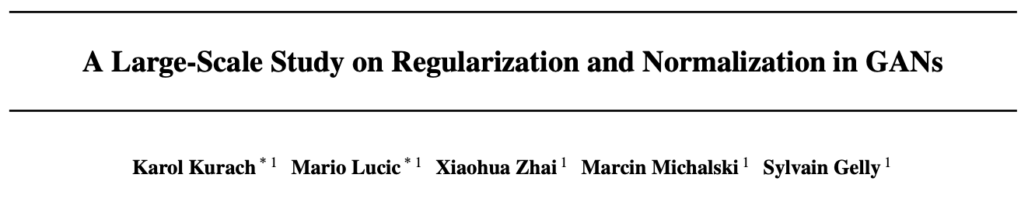
How People Handle The Problems?
Various Methods and Techniques Are Proposed
Heuristic Techniques
Neural Architecture Changes
Hyperparameter Tuning
Normalization Schemes
Non-trivial Amount of Tricks
Theoretical Based Techniques
Loss Function Re-formulation
Loss Function Regularization
Lucic, et.al, @ NIPS 2018
Kurach, et.al, @ ICML 2018
Kurach, et.al, @ ICML 2019

Slide 8
Outline
Known Problems in GANs
Beyond KL and JS Divergences
Introduction to Optimal Transport
Wasserstein GAN Formulation (WGAN)
WGAN Regularization Techniques

Slide 9
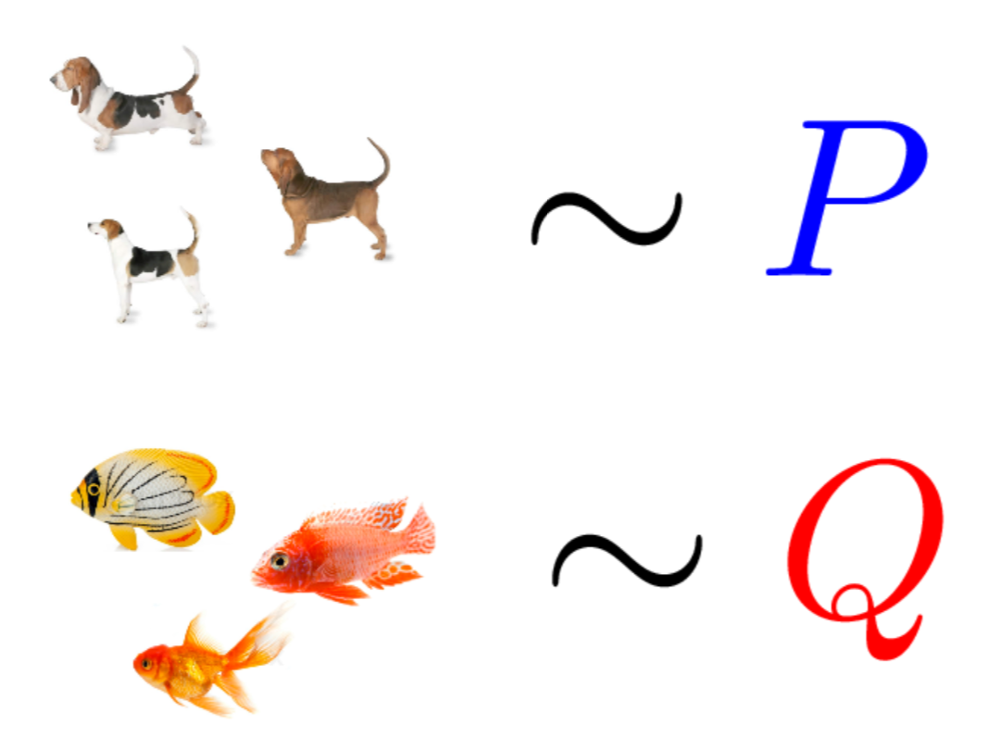
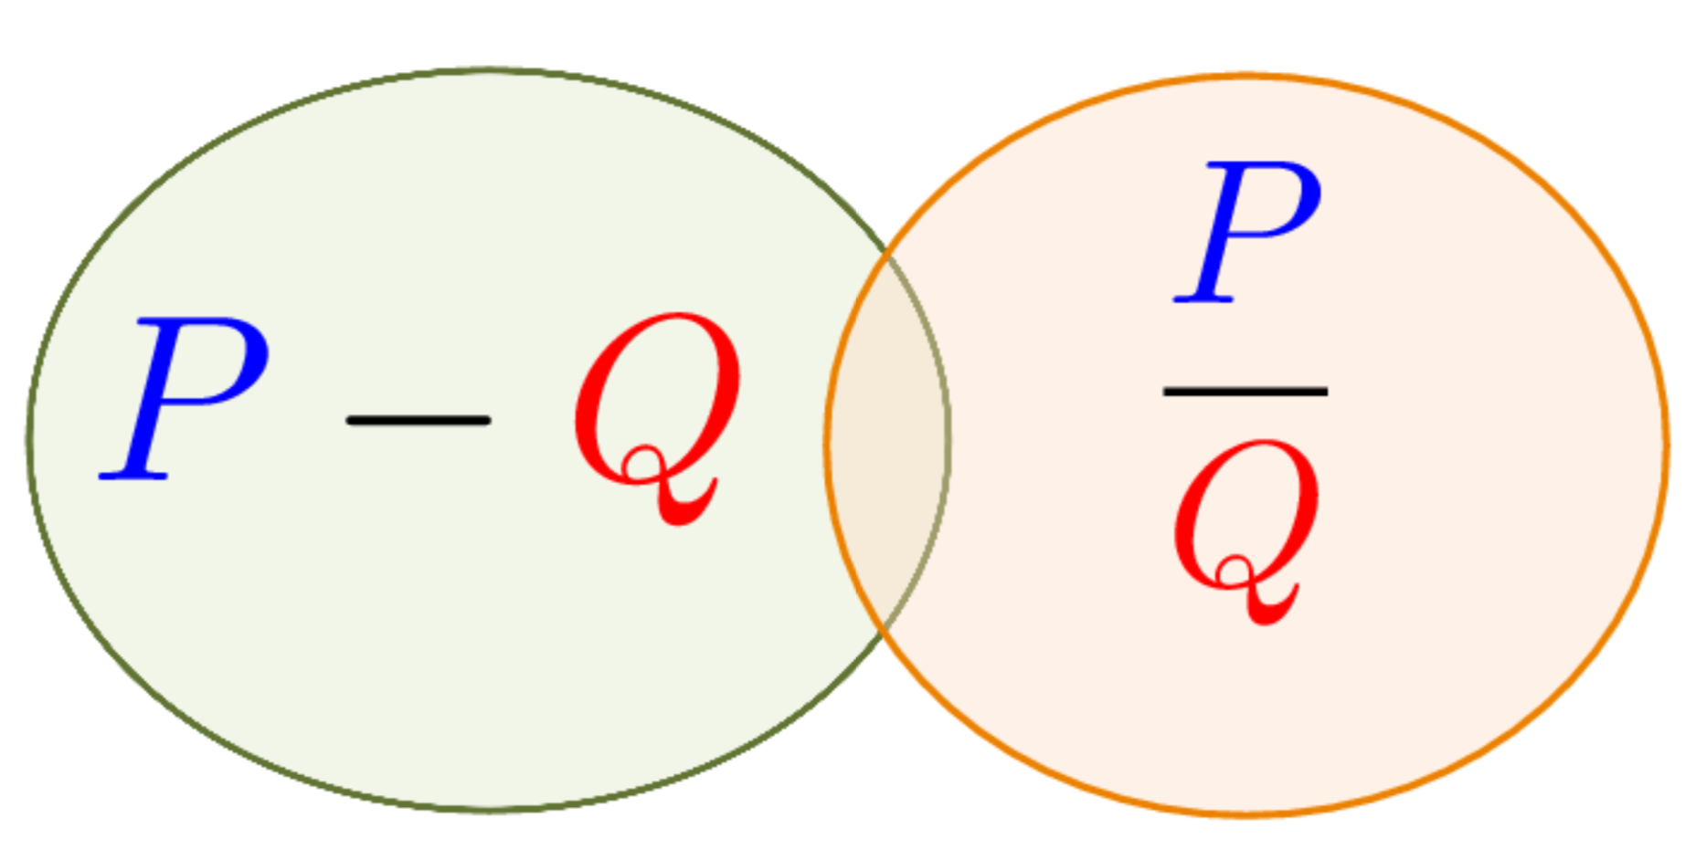
GANs Divergence Formulations
Have: Two collections of samples X; Y from unknown distributions P and Q.
Goal: Learn distinguishing features that indicate how P and Q differ.
Divergences

Slide 10
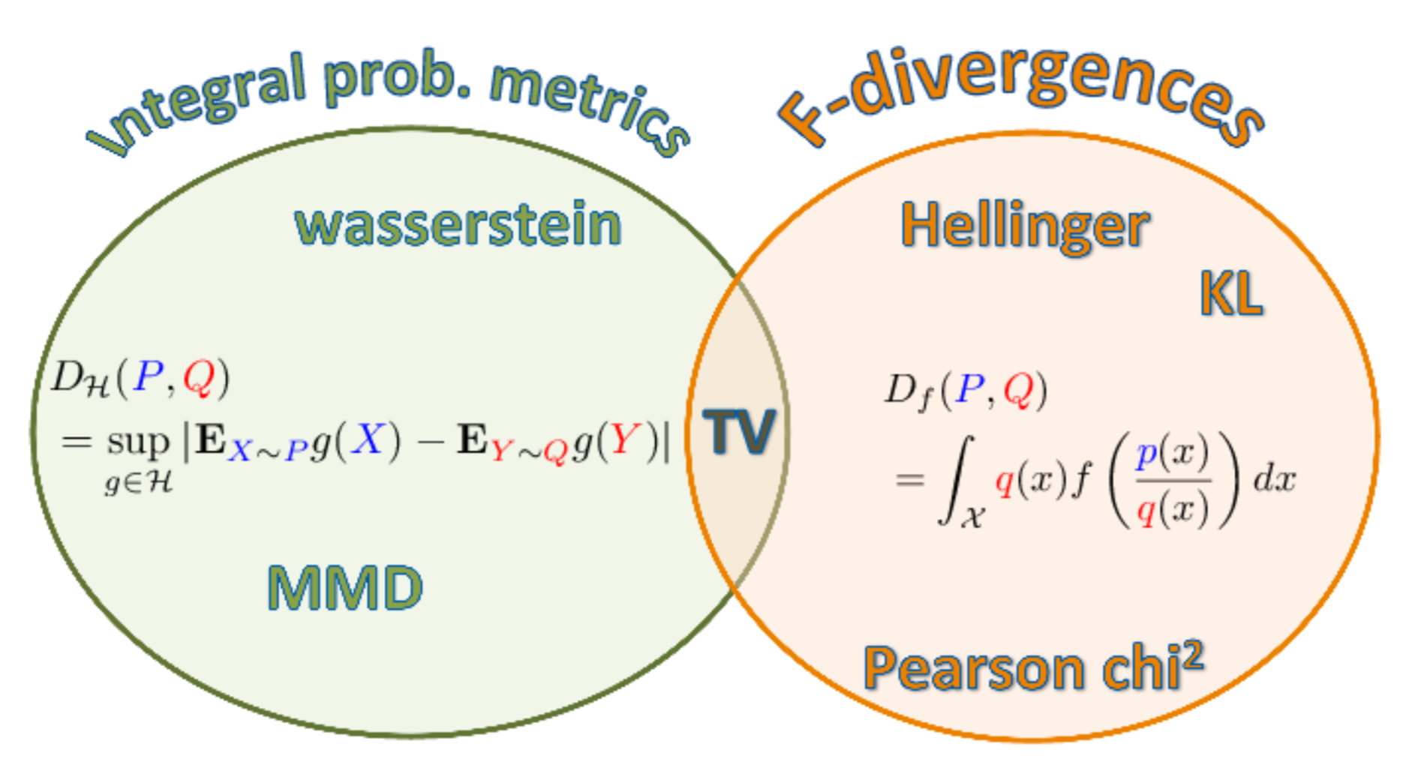
Types of GAN Divergences
GANs offer much more flexibility in the definition of distance or divergence.
Each type of divergence gives different behaviour of convergence.
Characteristics:
+ Good sample complexity (MMD)
+ Good geometry property (OT)
+ Metrize weak convergence
+ Mapping between measures (OT)
- Costly computation (OT)
Characteristics:
+ Simple computation
- Not metrize weak convergence
- No mapping between measures
The focus of this lecture is on Integral Probability Metric based Wasserstein GANs

Slide 11
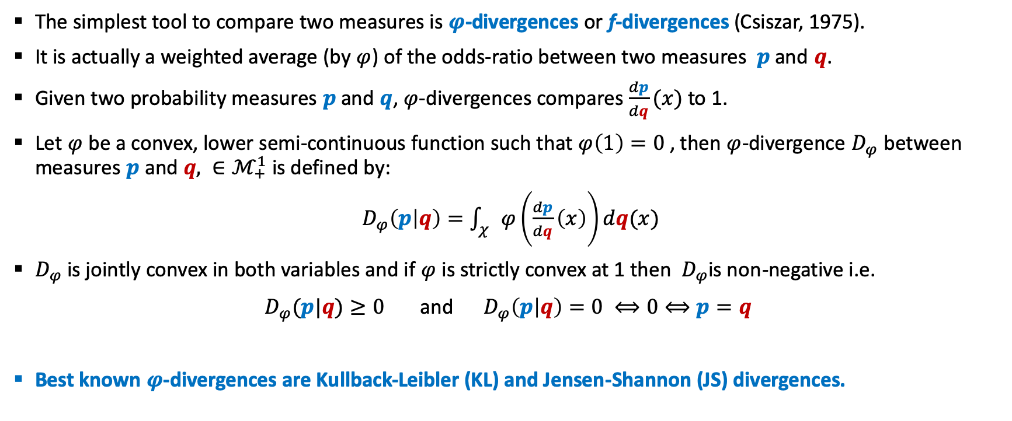
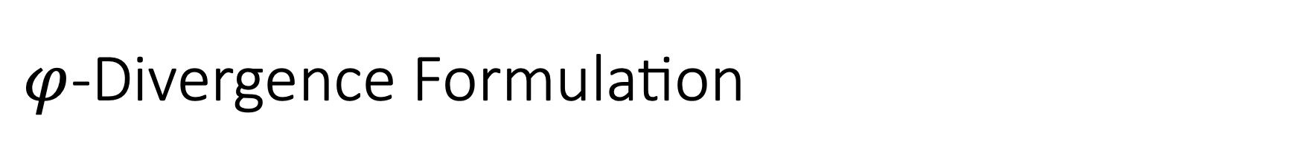
$φ$-Divergence Formulation
The simplest tool to compare two measures is $φ$-divergences or f-divergences (Csiszar, 1975).
It is actually a weighted average (by $φ$) of the odds-ratio between two measures $p$ and $q$.
Given two probability measures $p$ and $q$, $φ$-divergences compares $\frac{dp}{dq}(x)$ to 1.
Let $φ$ be a convex, lower semi-continuous function such that $φ\left(1\right)=0$ , then $φ$-divergence $D_{φ}$ between measures $p$ and $q, ∈ℳ_{+}^{1}$ is defined by:
$D_{φ}\left(p | q\right)=\int_{χ}{φ\left(\frac{dp}{dq}\left(x\right)\right)dq(x)}$
$D_{φ}$ is jointly convex in both variables and if $φ$ is strictly convex at 1 then $D_{φ}$is non-negative i.e.
$D_{φ}(p|q)≥0$ and $D_{φ}\left(p | q\right)=0 ⟺0⟺p=q$
Best known $φ$-divergences are Kullback-Leibler (KL) and Jensen-Shannon (JS) divergences.

Slide 12
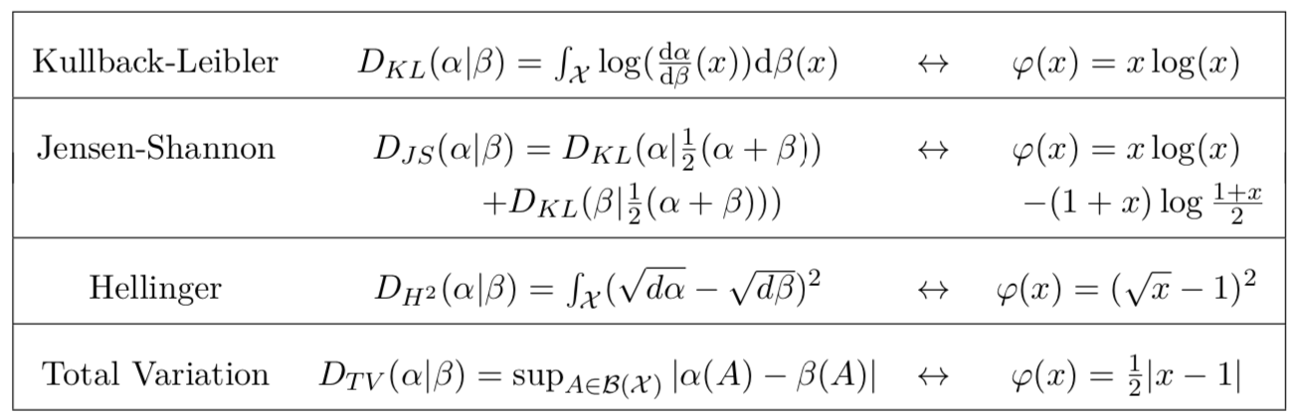
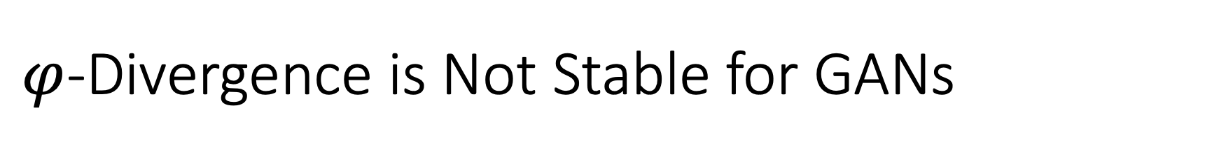
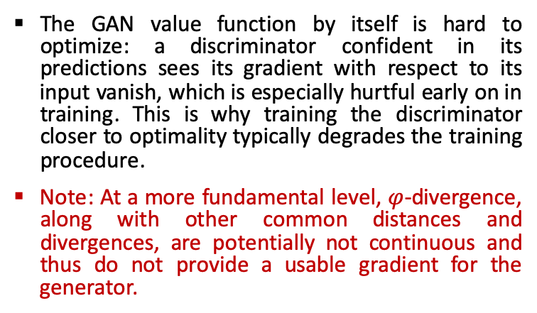
$φ$-Divergence is Not Stable for GANs
In NS-GANs, if the discriminator is trained to optimality before each generator parameter update, then minimizing the value function amounts to minimizing the Kullback-Leibler (KL) or Jensen-Shannon (JS) divergence between the data and model distributions on x. Doing so is expensive and often leads to vanishing gradients as the discriminator saturates; in practice, this requirement is relaxed, and the generator and the discriminator are updated simultaneously.
The consequence of this relaxation is that generator updates minimize a stochastic lower-bound to the KL/JS-divergence. Minimizing a lower bound can lead to meaningless gradient updates, since pushing down the lower bound doesn’t imply that the loss is actually decreasing, even as the bound goes to 0. This inherent problem in GANs of trading off unreliable updates and vanishing gradients is one of the main causes of GAN instability.
The GAN value function by itself is hard to optimize: a discriminator confident in its predictions sees its gradient with respect to its input vanish, which is especially hurtful early on in training. This is why training the discriminator closer to optimality typically degrades the training procedure.
Note: At a more fundamental level, $φ$-divergence, along with other common distances and divergences, are potentially not continuous and thus do not provide a usable gradient for the generator.
Notes:
In GANs, if the discriminator is trained to optimality before each generator parameter update, then minimizing the value function amounts to minimizing the Jensen-Shannon (JS) divergence between the data and model distributions on x. Doing so is expensive and often leads to vanishing gradients as the discriminator saturates; in practice, this requirement is relaxed, and the generator and the discriminator are updated simultaneously.
The consequence of this relaxation is that generator updates minimize a stochastic lower-bound to the JS-divergence. Minimizing a lower bound can lead to meaningless gradient updates, since pushing down the lower bound doesn’t imply that the loss is actually decreasing, even as the bound goes to 0. This inherent problem in GANs of trading off unreliable updates and vanishing gradients is one of the main causes of GAN instability.
Again, the GAN value function by itself is hard to optimize: a discriminator confident in its predictions sees its gradient with respect to its input vanish, which is especially hurtful early on in training. This is why training the discriminator closer to optimality typically degrades the training procedure. So GANs typically produce very visually appealing samples, but are often very hard to train.
Note: At a more fundamental level, JS-Divergence, along with other common distances and divergences, are potentially not continuous and thus do not provide a usable gradient for the generator.

Slide 13
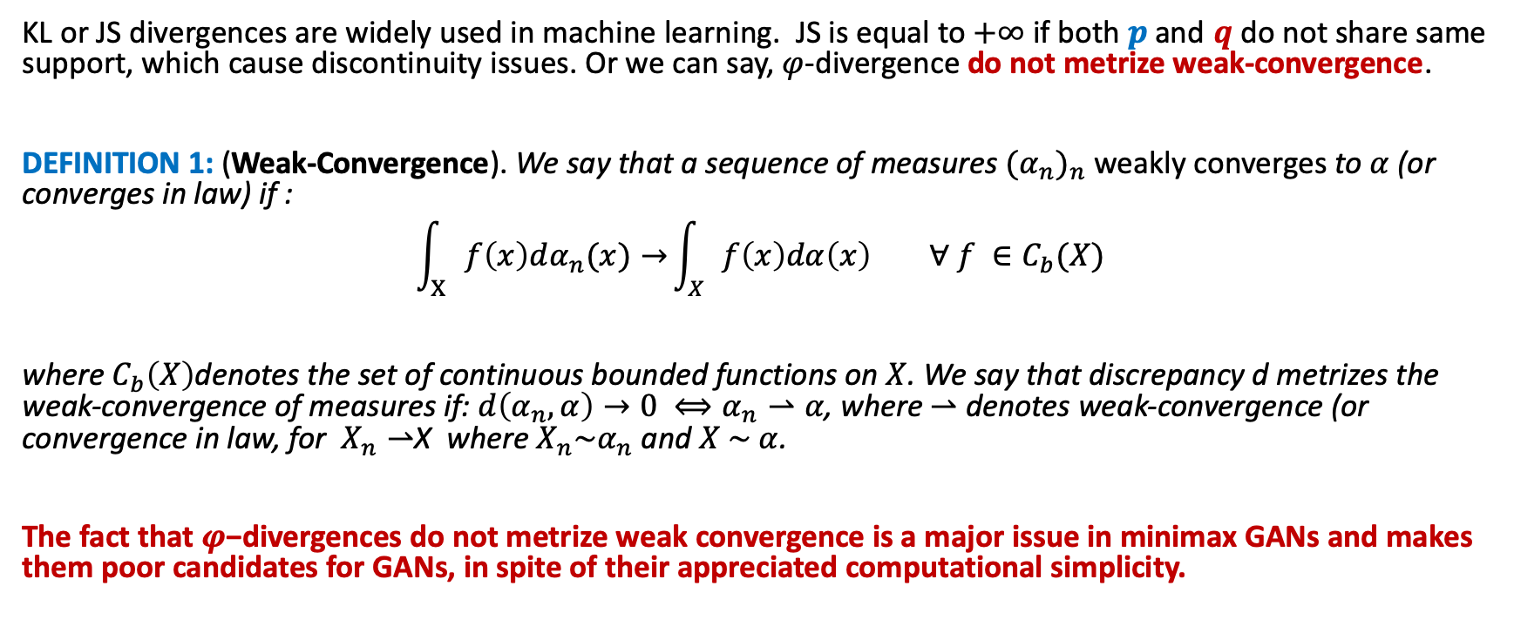
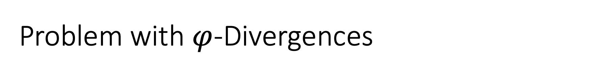
Problem with $φ$-Divergences
KL or JS divergences are widely used in machine learning. JS is equal to $+∞$ if both $p$ and $q$ do not share same support, which cause discontinuity issues. Or we can say, $φ$-divergence do not metrize weak-convergence.
DEFINITION 1: (Weak-Convergence). We say that a sequence of measures ${(α_{n})}_{n}$ weakly converges to $α$ (or converges in law) if :
$$\int_{Χ}{f\left(x\right)dα_{n}(x)→}\int_{Χ}{f\left(x\right)dα\left(x\right) ∀ f ∈C_{b}(X)}$$
where $C_{b}\left(X\right)$denotes the set of continuous bounded functions on $X$. We say that discrepancy d metrizes the weak-convergence of measures if: $d\left(α_{n},α\right)→0 ⟺α_{n}⇀α$, where $⇀$ denotes weak-convergence (or convergence in law, for $X_{n}⇀$X where $X_{n}\sim α_{n}$ and $X \sim α$.
The fact that $φ$−divergences do not metrize weak convergence is a major issue in minimax GANs and makes them poor candidates for GANs, in spite of their appreciated computational simplicity.

Slide 14
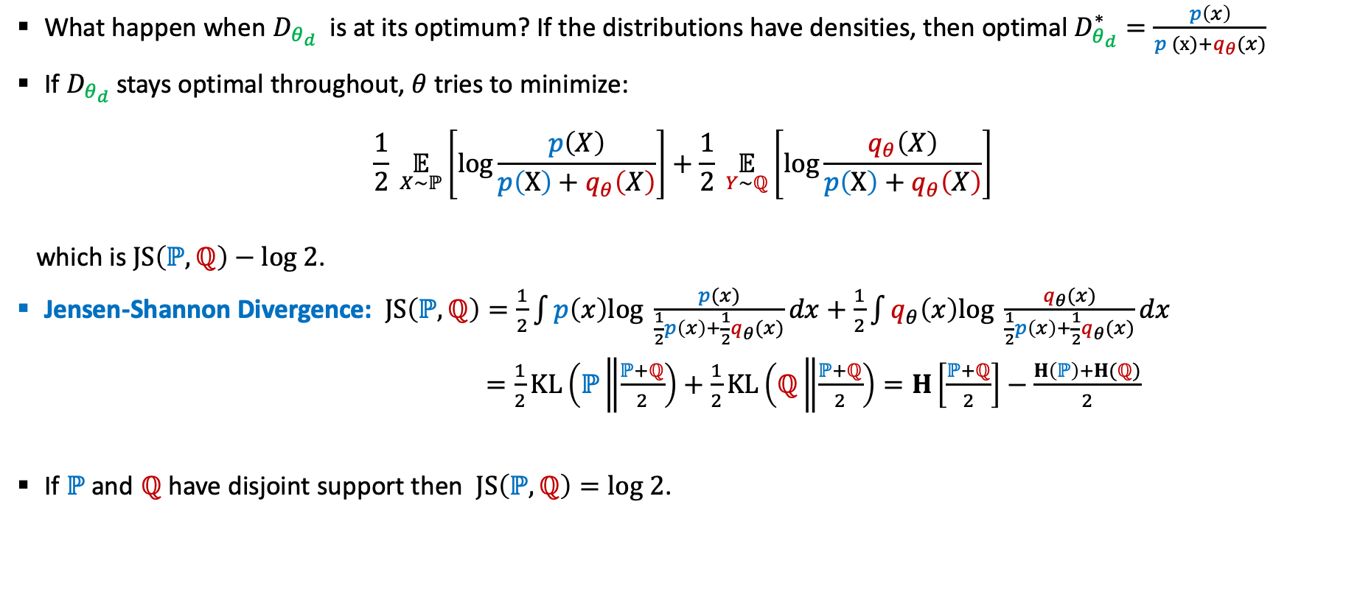
NS-GAN: Distance Between Distributions
What happen when $D_{θ_{d}}$ is at its optimum? If the distributions have densities, then optimal $D_{θ_{d}}^{∗}=\frac{p\left(x\right)}{p (x)+q_{θ}(x)}$
If $D_{θ_{d}}$ stays optimal throughout, $θ$ tries to minimize:
$$\frac{1}{2} \underset{X\sim ℙ}{𝔼}\left[log\frac{p\left(X\right)}{p\left(X\right)+q_{θ}\left(X\right)}\right]+\frac{1}{2} \underset{Y\sim ℚ}{𝔼}\left[log\frac{q_{θ}\left(X\right)}{p\left(X\right)+q_{θ}\left(X\right)}\right]$$
which is $JS\left(ℙ, ℚ\right)−log 2$.
Jensen-Shannon Divergence: $JS\left(ℙ, ℚ\right)=\frac{1}{2}\int{p\left(x\right)log \frac{p(x)}{\frac{1}{2}p\left(x\right)+\frac{1}{2}q_{θ}(x)}dx+}$ $\frac{1}{2}\int{q_{θ}\left(x\right)log \frac{q_{θ}(x)}{\frac{1}{2}p\left(x\right)+\frac{1}{2}q_{θ}(x)}dx}$
$=\frac{1}{2}KL\left(ℙ\left\|\frac{ℙ+ℚ}{2}\right.\right)+\frac{1}{2}KL\left(ℚ\left\|\frac{ℙ+ℚ}{2}\right.\right)=H\left[\frac{ℙ+ℚ}{2}\right]−\frac{H\left(ℙ\right)+H(ℚ)}{2}$
If $ℙ$ and $ℚ$ have disjoint support then $JS\left(ℙ, ℚ\right)=log 2$.

Slide 15
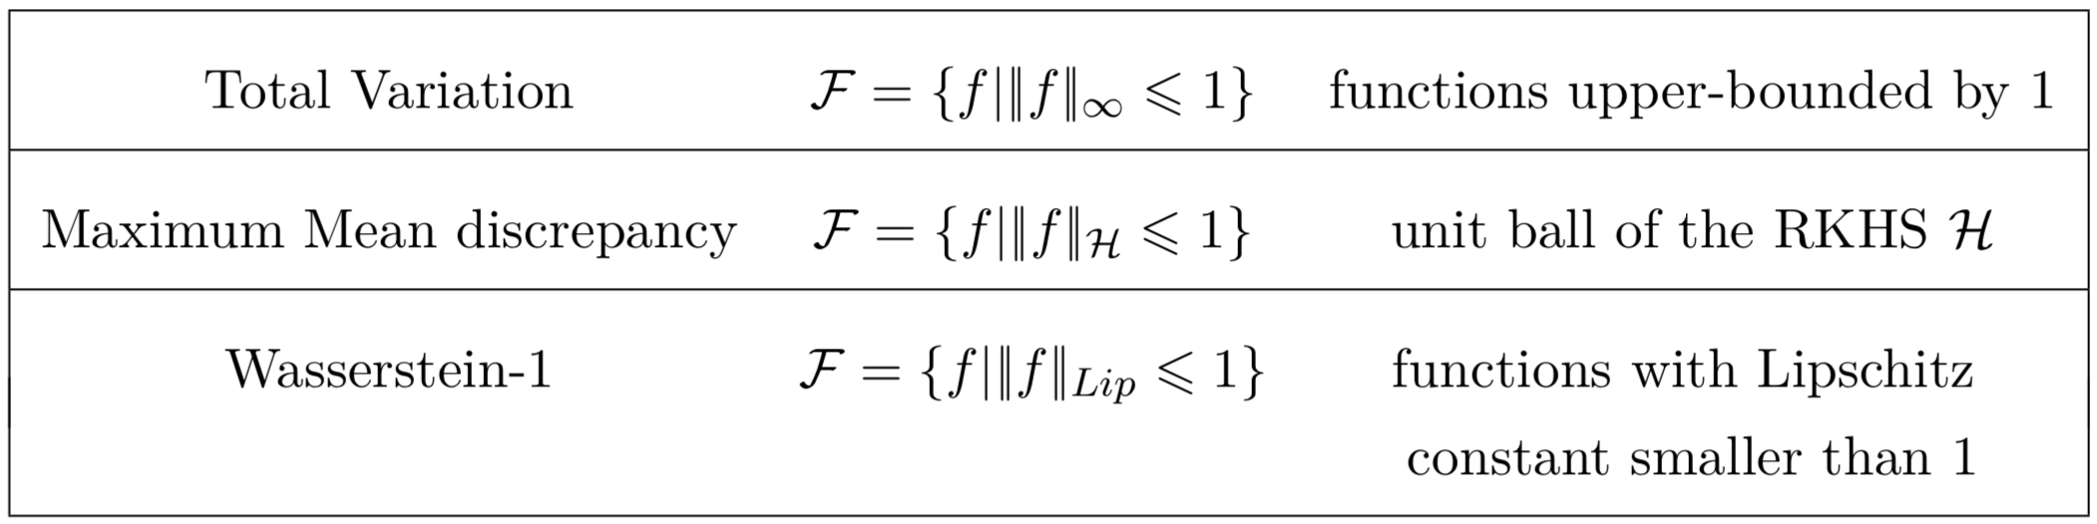
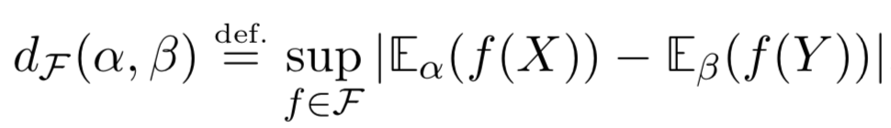
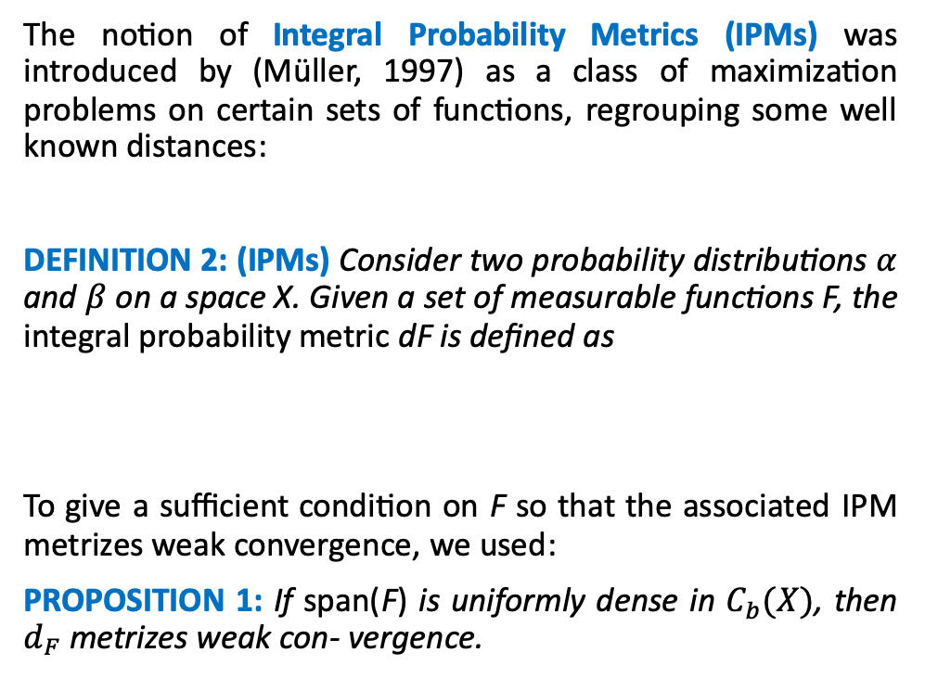
Integral Probability Metric Divergences
The notion of Integral Probability Metrics (IPMs) was introduced by (Müller, 1997) as a class of maximization problems on certain sets of functions, regrouping some well known distances:
DEFINITION 2: (IPMs) Consider two probability distributions $α$ and $β$ on a space X. Given a set of measurable functions F, the integral probability metric dF is defined as
To give a sufficient condition on F so that the associated IPM metrizes weak convergence, we used:
PROPOSITION 1: If span(F) is uniformly dense in $C_{b}(X)$, then $d_{F}$metrizes weak con- vergence.
Maximum Mean Discrepancy:
+ Good sample complexity
+ Metrize weak convergence
+ Cheaper computation
- No mapping between measures
Optimal Transport (Wasserstein-1):
+ Metrize
+ Mapping between measures
+ Good geometry property
- Costly computation

Slide 16
Outline
Known Problems in GANs
Beyond KL and JS Divergences
Introduction to Optimal Transport
Wasserstein GAN Formulation (WGAN)
WGAN Regularization Techniques

Slide 17
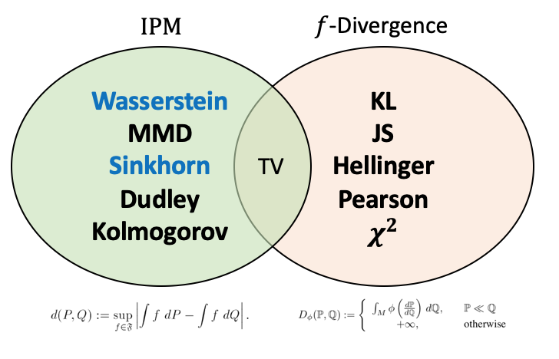

Why IPM and Optimal Transport
The $φ$-divergence is hard to estimate in high dimension and not stable for GANs
IPM is relatively simple to estimate and approximate in high dimension
IPM Estimators distances exhibit better convergence behavior than KLD
Part of IPM:
Dudley Metric
Kolmogorov Divergence
Sobolev Divergence
Total Variation Divergence
Wasserstein Divergence (EM-Distance)
EOT – Sinkhorn Divergence
Maximum Mean Discrepancy
Why OT and EOT:
Better empiric performance of IPM
IPM and OT are simple to approximate
OT performs better in high-dimension
OT showed better convergence and geometry
No mode collapse and vanishing gradients
Space for theoretical study OT & EOT

Slide 18
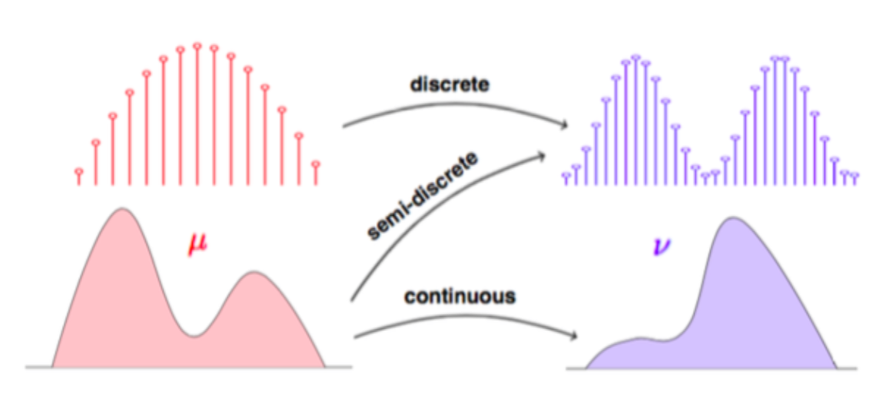
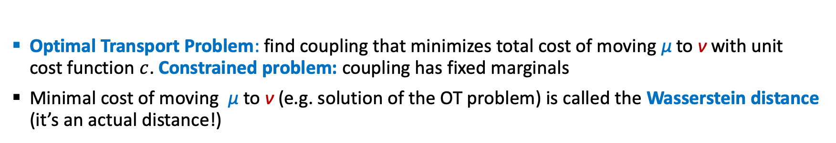
Optimal Transport Theory
Optimal Transport Problem: find coupling that minimizes total cost of moving μ to ν with unit cost function $c$. Constrained problem: coupling has fixed marginals
Minimal cost of moving μ to ν (e.g. solution of the OT problem) is called the Wasserstein distance (it’s an actual distance!)

Slide 19
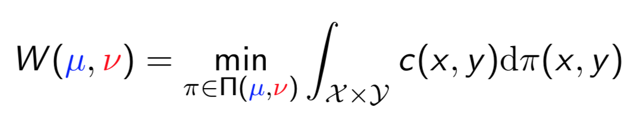
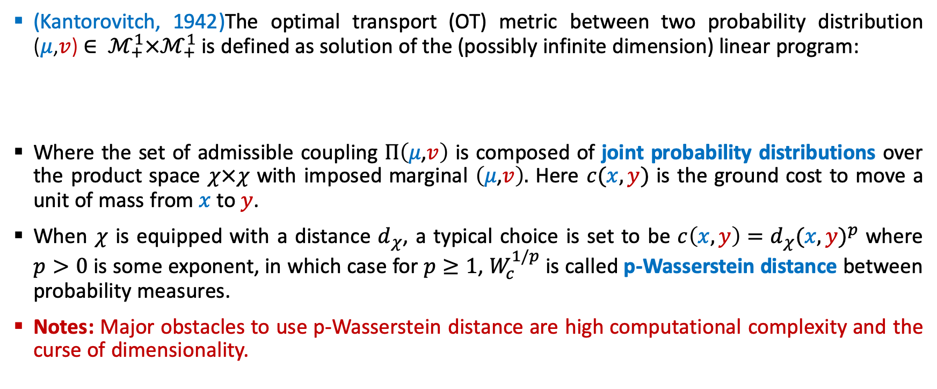
Optimal Transport Distance
(Kantorovitch, 1942)The optimal transport (OT) metric between two probability distribution ($μ$,$v$)$∈ ℳ_{+}^{1}×ℳ_{+}^{1}$ is defined as solution of the (possibly infinite dimension) linear program:
Where the set of admissible coupling $Π\left(μ\text{,}v\right)$ is composed of joint probability distributions over the product space $χ×χ$ with imposed marginal $\left(μ\text{,}v\right).$ Here $c(x,y)$ is the ground cost to move a unit of mass from $x$ to $y$.
When $χ$ is equipped with a distance $d_{χ}$, a typical choice is set to be $c\left(x,y\right)=d_{χ}{(x,y)}^{p}$ where $p>0$ is some exponent, in which case for $p≥1$, $W_{c}^{1/p}$ is called p-Wasserstein distance between probability measures.
Notes: Major obstacles to use p-Wasserstein distance are high computational complexity and the curse of dimensionality.

Slide 20
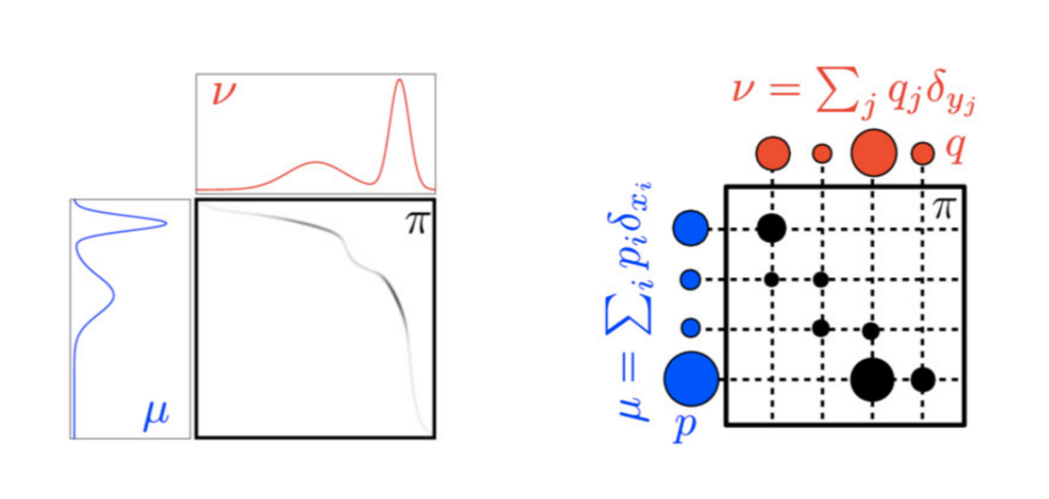
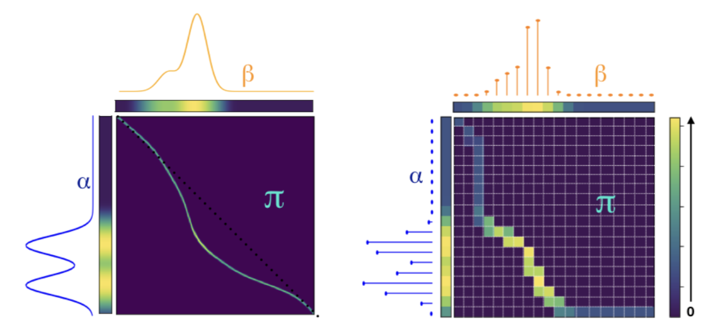

The Wasserstein Distance
Ground cost c(x,y) to move a unit of mass from x to y
Constrained set of couplings Π(μ,ν) with marginals μ and ν
For $c\left(x,y\right)= {\left\|x−y\right\|}_{2}^{p}$ the ${W_{c}(μ\text{,}v)}^{1/p}$ is the p-Wasserstein Distance.
What’s the coupling that minimizes the total cost of moving ALL the mass from$μ$to $v$ ?

Slide 21
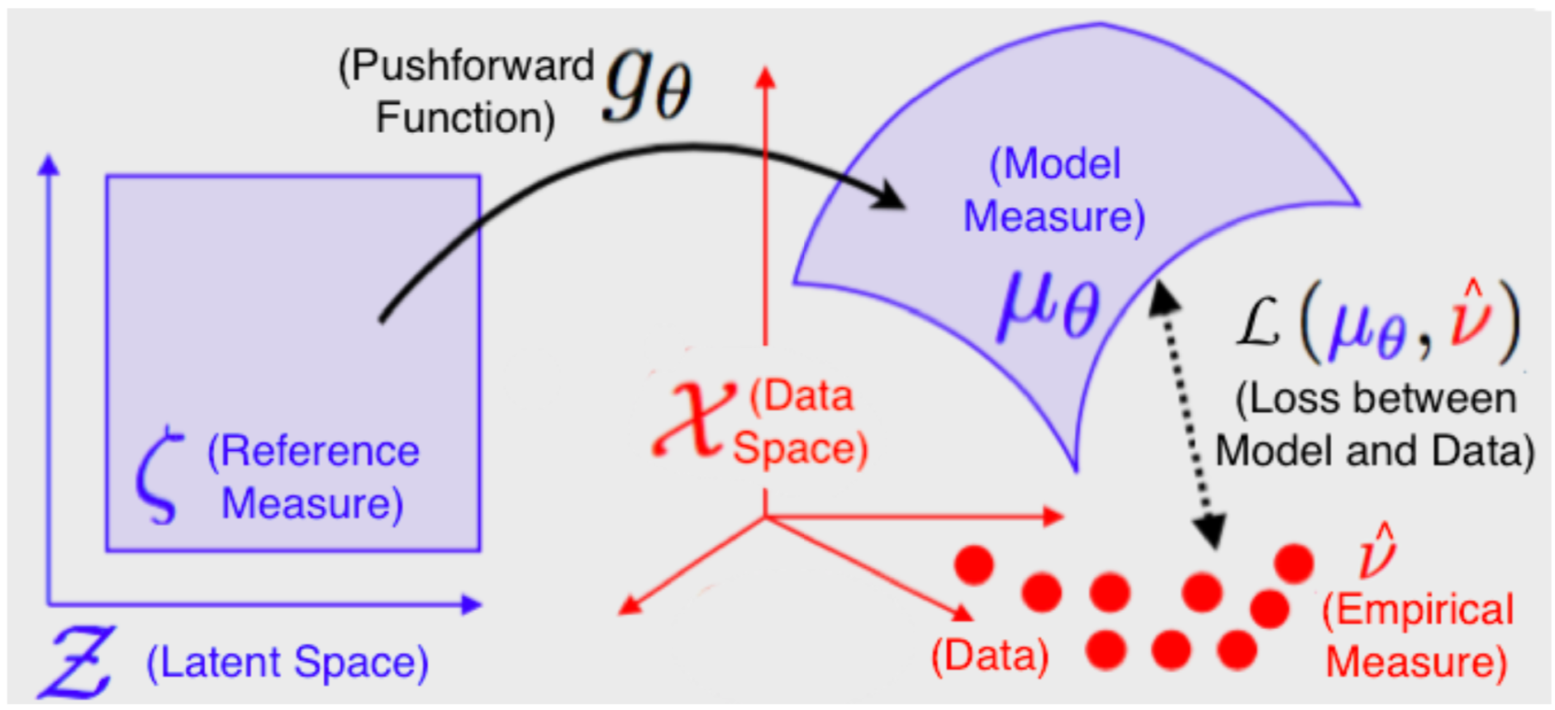
Generative Model with Optimal Transport
Illustration of Generative Model

Slide 22
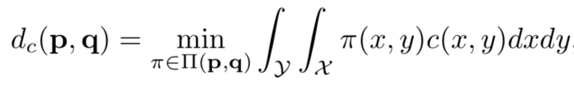
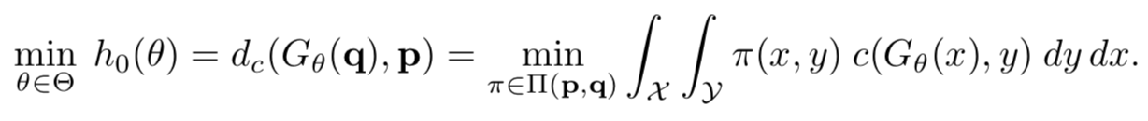
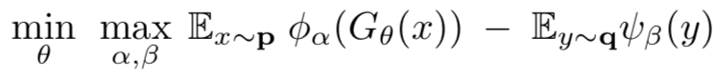

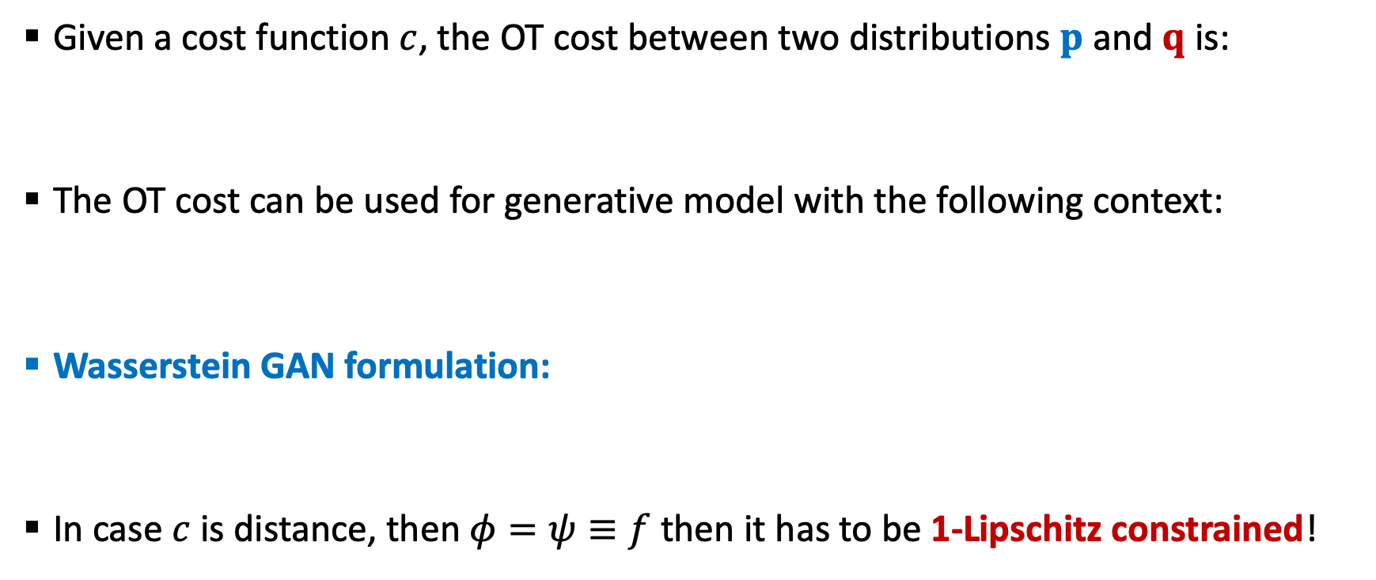
1-Lipschitz Constrained Requirement
Given a cost function $c$, the OT cost between two distributions $p$ and $q$ is:
The OT cost can be used for generative model with the following context:
Wasserstein GAN formulation:
In case $c$ is distance, then $φ=ψ≡f$ then it has to be 1-Lipschitz constrained!

Slide 23
Outline
Known Problems in GANs
Beyond KL and JS Divergences
Introduction to Optimal Transport
Wasserstein GAN Formulation (WGAN)
WGAN Regularization Techniques

Slide 24
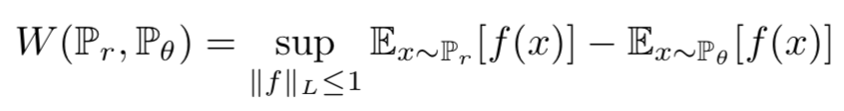
WGAN Introduction
Wasserstein distance produces a value function which has better theoretical properties than JSD value functions.
The new value function f (called critic as it is not classifier) requires the discriminator must lie within the space of 1-Lipschitz functions, which the WGAN enforces through weight clipping.
However, weight clipping in the discriminator can lead to pathological behavior which hurts stability and performance. This problem can be solved using WGAN with gradient penalty later.
WGAN provides better convergence properties of the value function.

Slide 25
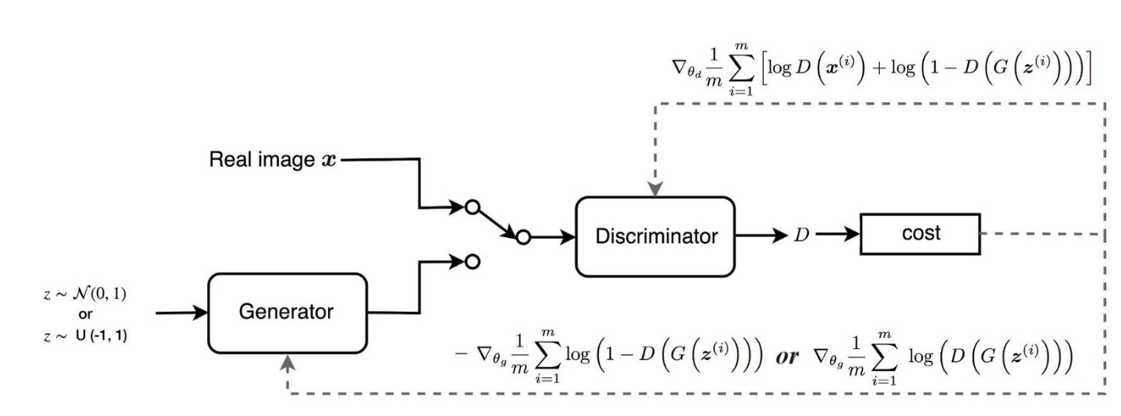
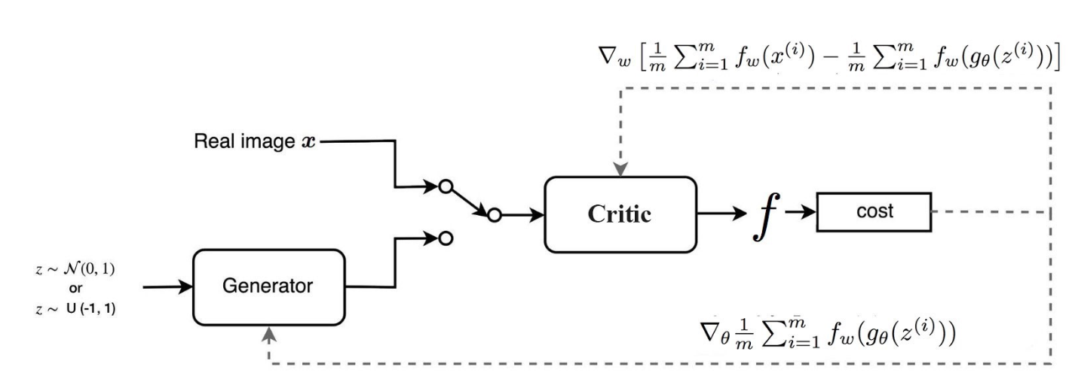
MM/NS-GAN vs WGAN
MM-GAN / NS-GAN
WGAN

Slide 26
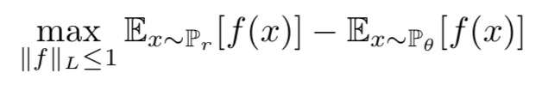
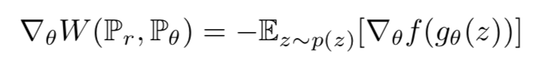
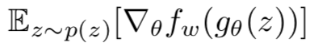
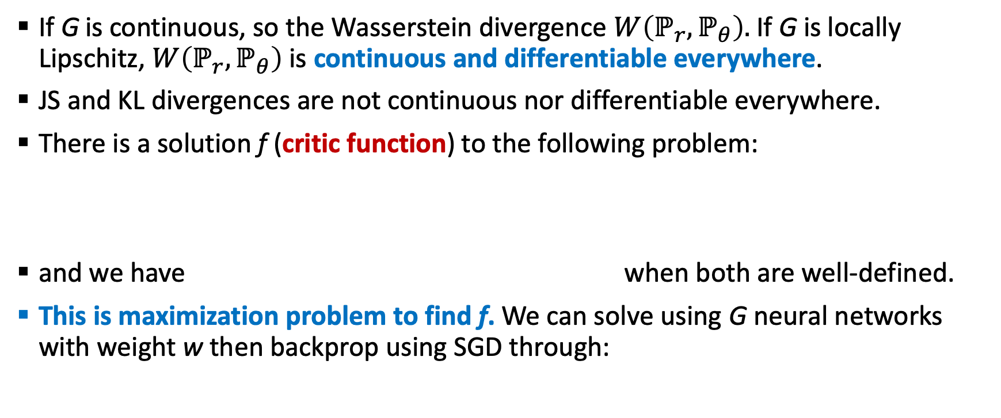
WGAN Optimization
If G is continuous, so the Wasserstein divergence $W\left(ℙ_{r},ℙ_{θ}\right).$If G is locally Lipschitz, $W\left(ℙ_{r},ℙ_{θ}\right)$ is continuous and differentiable everywhere.
JS and KL divergences are not continuous nor differentiable everywhere.
There is a solution f (critic function) to the following problem:
and we have when both are well-defined.
This is maximization problem to find f. We can solve using G neural networks with weight w then backprop using SGD through:

Slide 27
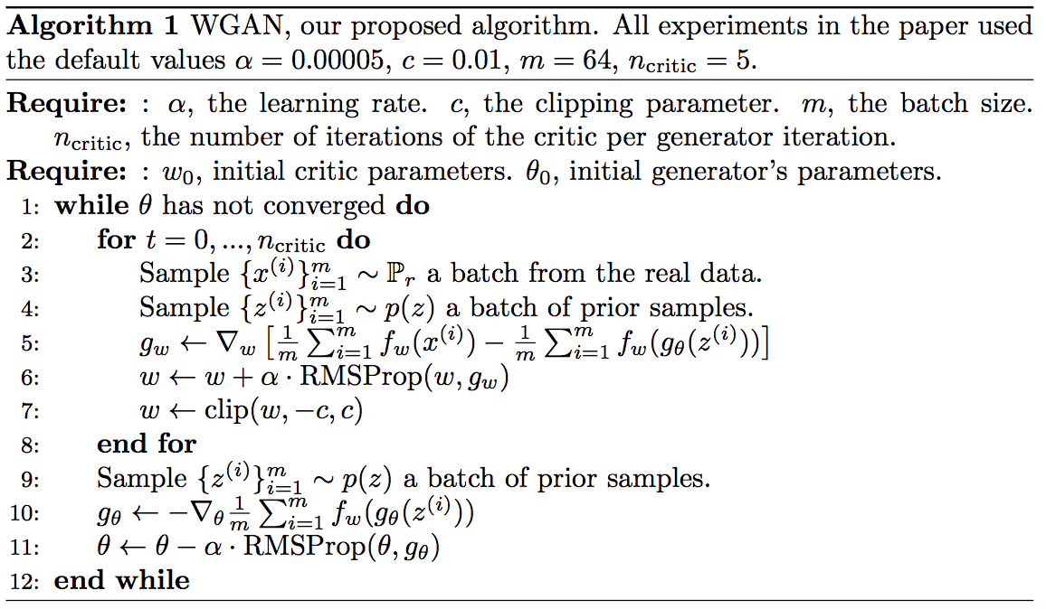
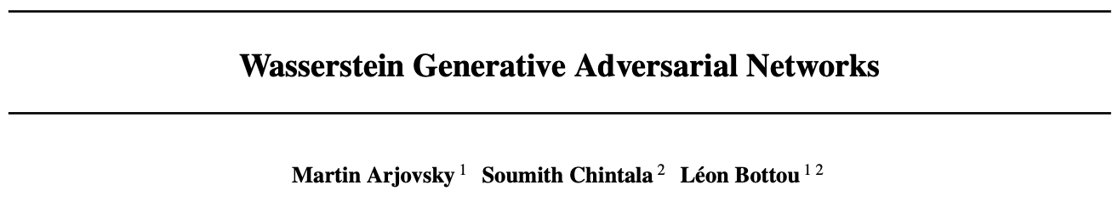
WGAN (Arjovsky, et.al, @ ICML 2017)
Introduced a new algorithm named WGAN, an alternative to traditional GAN training. In WGAN, one can improve the stability of learning, get rid of problems like mode collapse, and provide meaningful learning curves useful for debugging and hyperparameter searches.
Furthermore, this paper shows that the corresponding optimization problem is sound, and provide extensive theoretical work highlighting the deep connections to different distances between distributions.

Slide 28
WGAN Advantages
Training WGANs does not require maintaining a careful balance in training of the D and G, and does not require a careful design of the network architecture either. The mode dropping phenomenon that is typical in GANs is also drastically reduced.
One of the most compelling practical benefits of WGANs is the ability to continuously estimate the EM distance by training the discriminator to optimality. Plotting these learning curves is not only useful for debugging and hyperparameter searches, but also correlate remarkably well with the observed sample quality.
One of the benefits of WGAN is that it allows us to train the critic till optimality. When the critic is trained to completion, it simply provides a loss to the generator that we can train as any other neural network. This tells us that we no longer need to balance generator and discriminator’s capacity properly. The better the critic, the higher quality the gradients we use to train the generator.
We observe that WGANs are much more robust than GANs when one varies the neural architectural choices for the generator like DCGAN, DenseNet and ResNet.

Slide 29
Outline
Known Problems in GANs
Beyond KL and JS Divergences
Introduction to Optimal Transport
Wasserstein GAN Formulation (WGAN)
WGAN Regularization Techniques

Slide 30
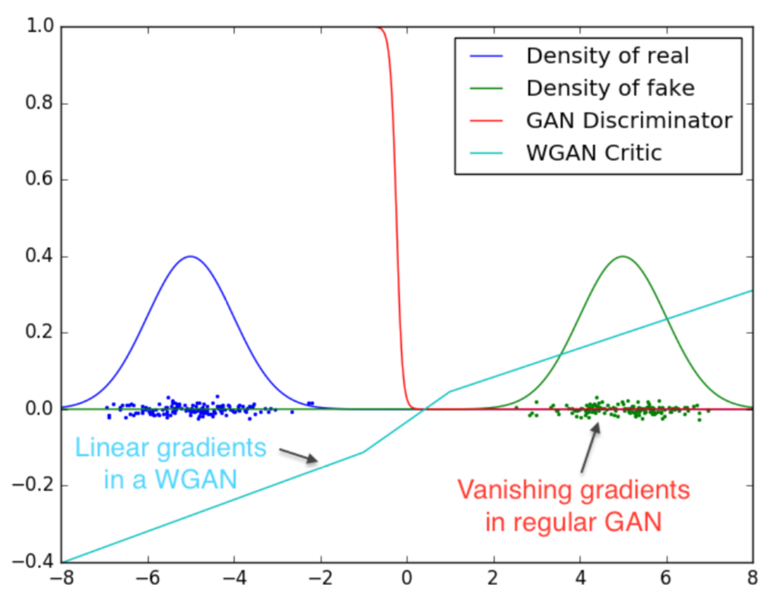
WGAN Regularization
WGAN critic function is better than traditional GANs discriminator as it shows vanishing gradient and saturates. However, weight clipping in initial WGAN is a clearly terrible way to enforce a Lipschitz constraint. If the clipping parameter is large, then it can take a long time for any weights to reach their limit, thereby making it harder to train the critic till optimality.
To avoid the problem, we use these techniques:
Gradient Penalty
Wasserstein Divergence
Spectral Normalization

Slide 31
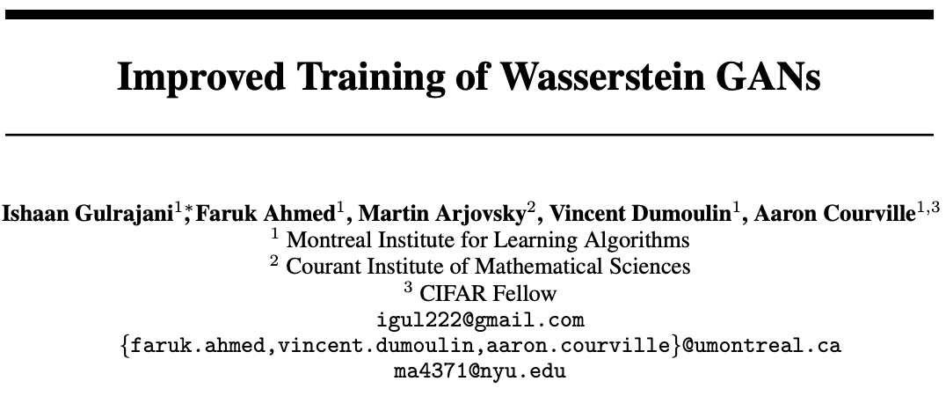
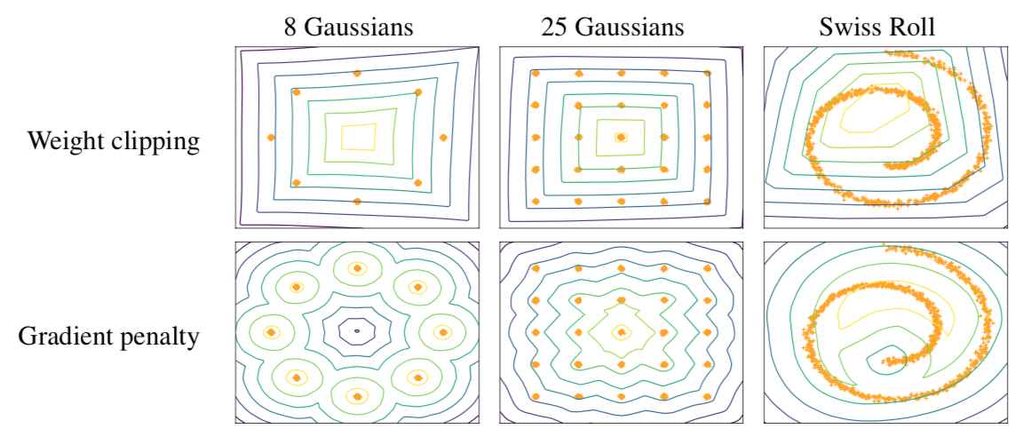
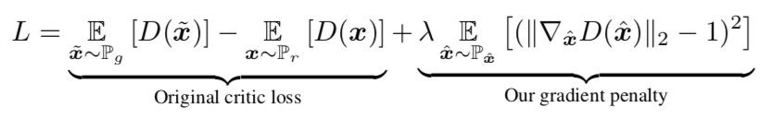
WGAN-GP (Guljarani, et.al, @ NIPS 2017)
Alternative way to enforce Lipschitz constraint by penalizing the norm of gradient of the critic with respect to its input. WGAN-GP is faster and can generate more realistic samples.
How it works: at certain points samples from a distribution over the input space x, evaluate the gradient of the critic and penalized its square distance from 1 in the critic loss function. New objective of WGAN-GP:

Slide 32
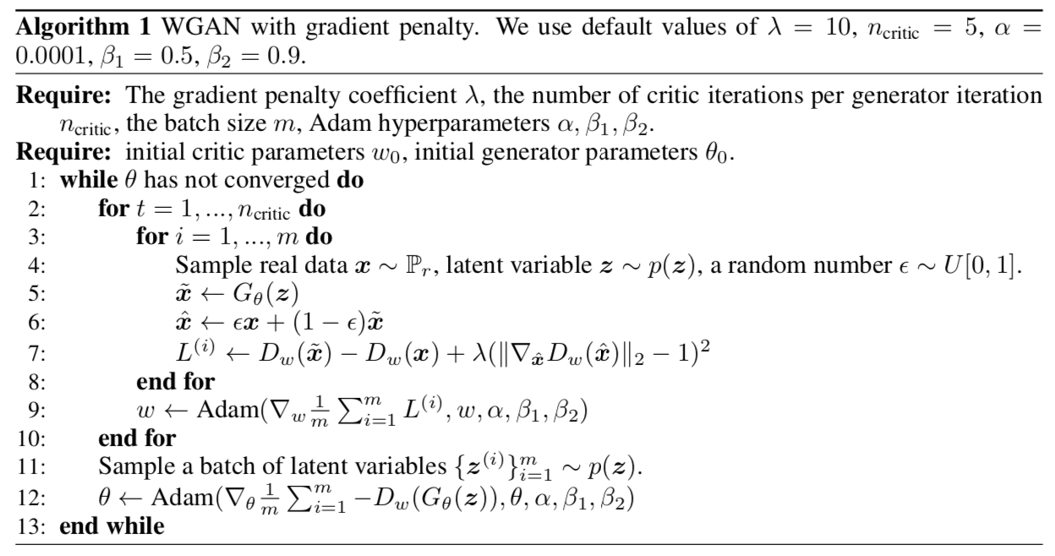
WGAN-GP Algorithm

Slide 33
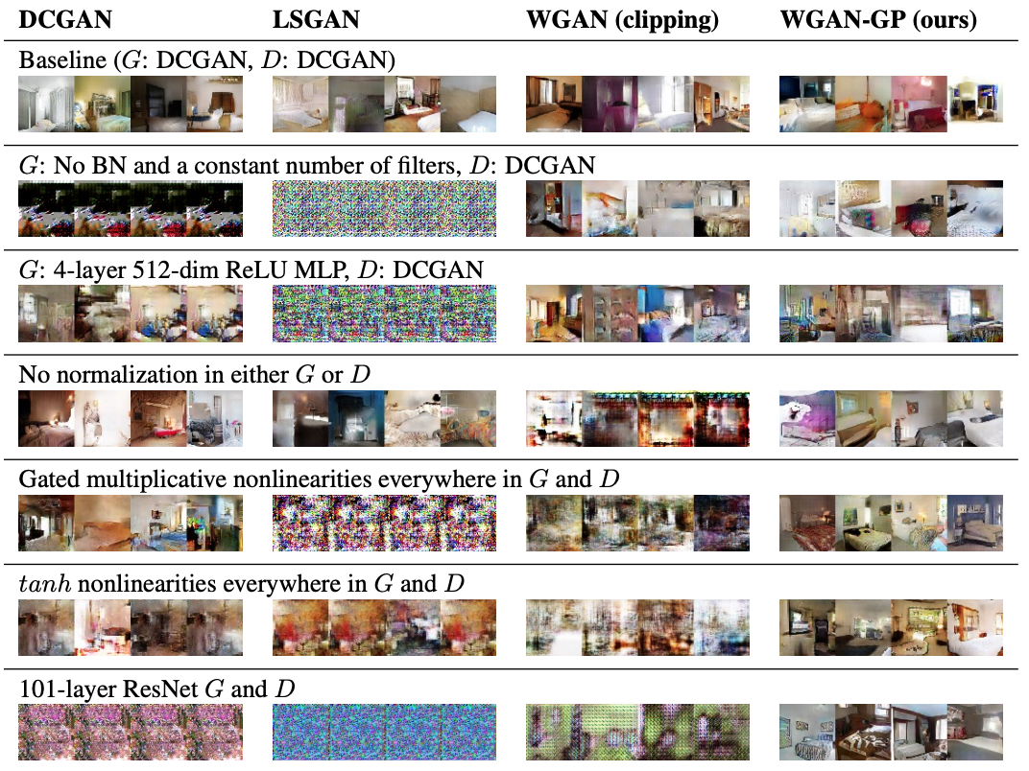
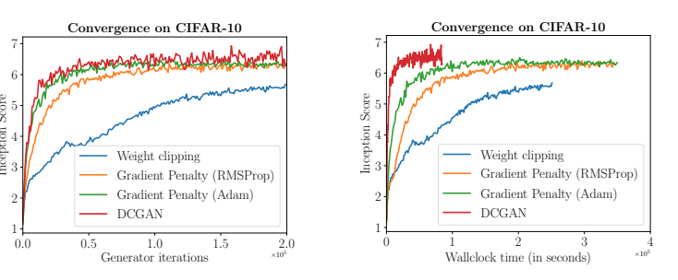

WGAN-GP Experiment Results

Slide 34





SN-GAN (Miyato, et.al, @ ICLR 2018)
Spectral normalization (SN) technique to stabilize training of discriminator. SN normalizes weight matrices and controls the Lipschitz constant of discriminator (critic f) by literally constraining the spectral norm of each layer of generator G.
Spectral norm of matrix A:
SN-GAN normalize weight matrix W so that it satisfies Lipschitz constraint $σ\left(W\right)=1$ so that:

Slide 35




SN-GAN Experiment Results
CIFAR-10
STL-10

Slide 36



Wasserstein Divergence (WGAN-Div)
Relaxed version of Wasserstein divergence that does not require the K-Lipschitz constraint.
Relaxed Wasserstein divergence (WGAN-Div) is symmetric and smoothly approximate WGAN.
GAN optimization becomes:
Comparison to WGAN-GP:

Slide 37


WGAN-Div (Wu, et.al, @ ECCV 2018)

Slide 38



WGAN-Div Experiment Results

Slide 39
HOME WORK WEEK 2

Slide 40




Preparing Dataset & Train Your GANs
Public Dataset (MNIST, COCO, CelebA, ImageNet)
DSC-UI-SRIN Github: https://github.com/DSC-UI-SRIN
Train your WGANs at Collab
Paper Reading

Slide 41
Paper Reading
Neural Architecture, Regularizations and Normalization
Lucic, et.al, @ NIPS 2018
Kurach, et.al, @ ICML 2019
Wasserstein GANs and Regularizations
Arjovsky, et.al, @ ICML 2017
Guljarani, et.al, @ NIPS 2017
Miyato, et.al, @ ICLR 2018
Wu, et.al, @ ECCV 2018

